Slide 1
NETFLIX CONTENT ANALYSIS
Data Storytelling & Statistical Validation
Prepared by:
Y Yuva Teja

Slide 2
Project Objective
Analyze Netflix content dataset
Identify trends and patterns
Create interactive dashboard
Validate findings using statistics
Provide business insights

Slide 3
Dataset Overview
Total records: 8809
Movies: 6131
TV Shows: 2676
Columns analyzed:
Type
Country
Rating
Release Year

Slide 4
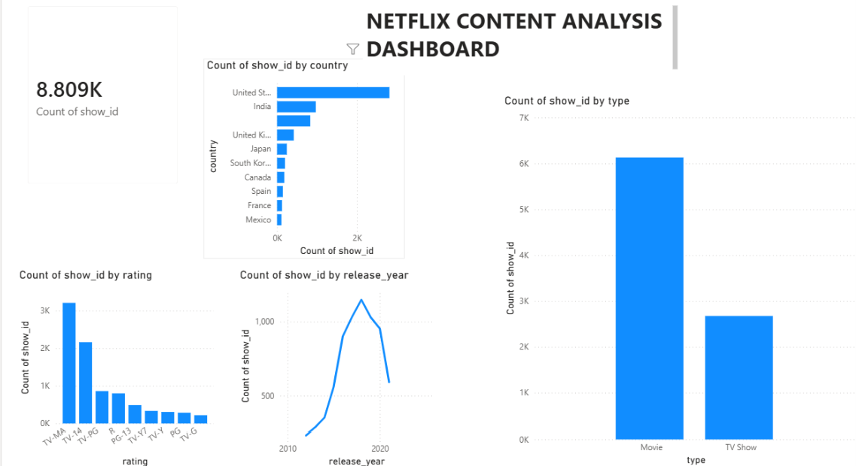
Power BI Dashboard
Key Findings:
• Movies dominate Netflix content.
• USA produces the highest content.
• TV-MA is the most common rating.

Slide 5
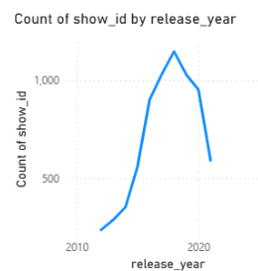
Content Growth Analysis
• Netflix content increased rapidly after 2015.
• Peak production occurred around 2019.
• Growth declined after 2020.

Slide 6
Statistical Validation
Hypothesis:
H0:
Movies and TV Shows are equally distributed.
H1:
Movies and TV Shows are not equally distributed.
Chi-square Statistic:
1355.40
P-value:
1.03 × 10^-296
Decision:
Reject H0
Conclusion:
The difference between Movies and TV Shows is statistically significant.

Slide 7
Business Recommendations
Continue investing in movies.
Expand TV show production.
Increase regional content.
Focus on popular ratings.
Use data-driven decision making.

Slide 8
Conclusion
Netflix content is dominated by movies.
USA is the largest content producer.
TV-MA is the most popular rating.
Content production peaked around 2019.
Statistical testing validated the findings.

